Slide 1
MODFLOW Background
Introduction to Groundwater Modeling using MODFLOW
January 9-13, 2023
SDSU – San Diego, California

Slide 2
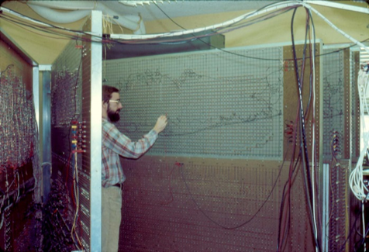

Slide 3
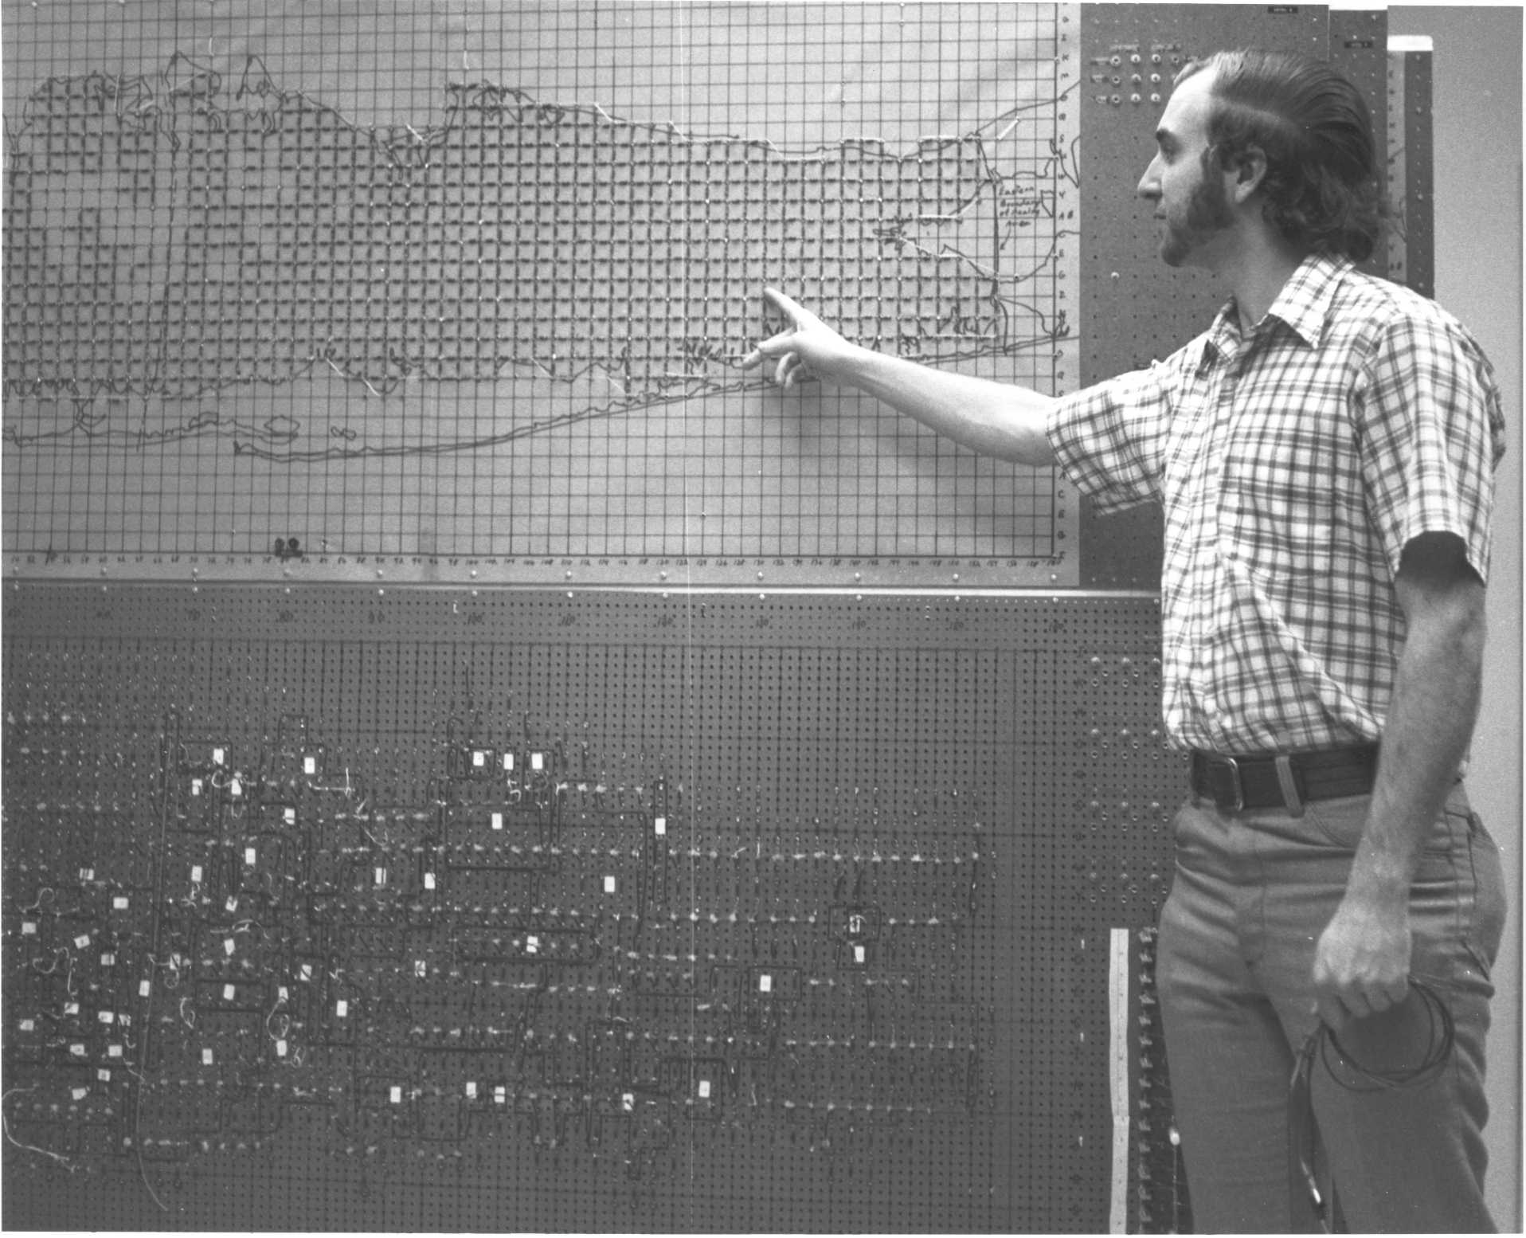
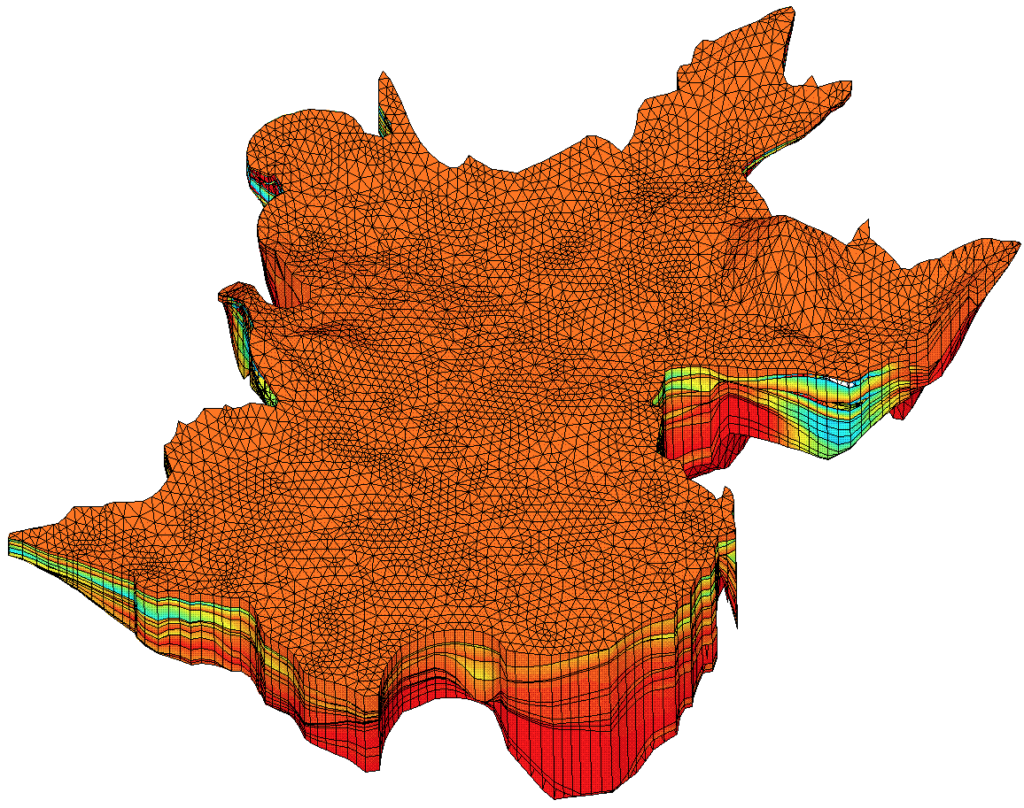
background

Slide 4
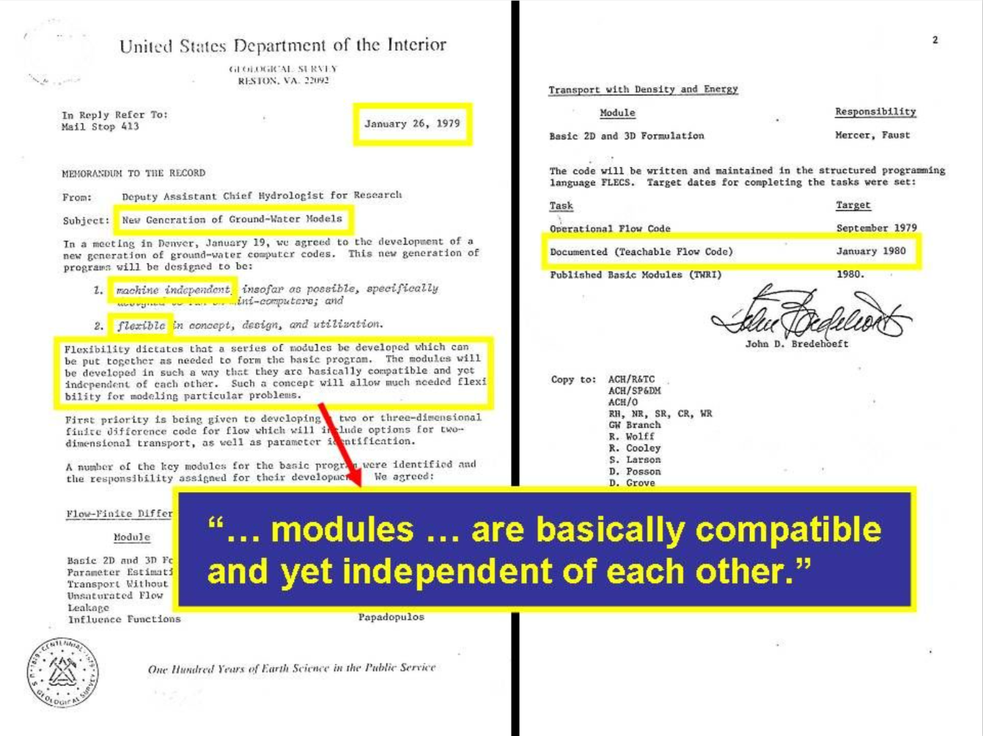

Slide 5
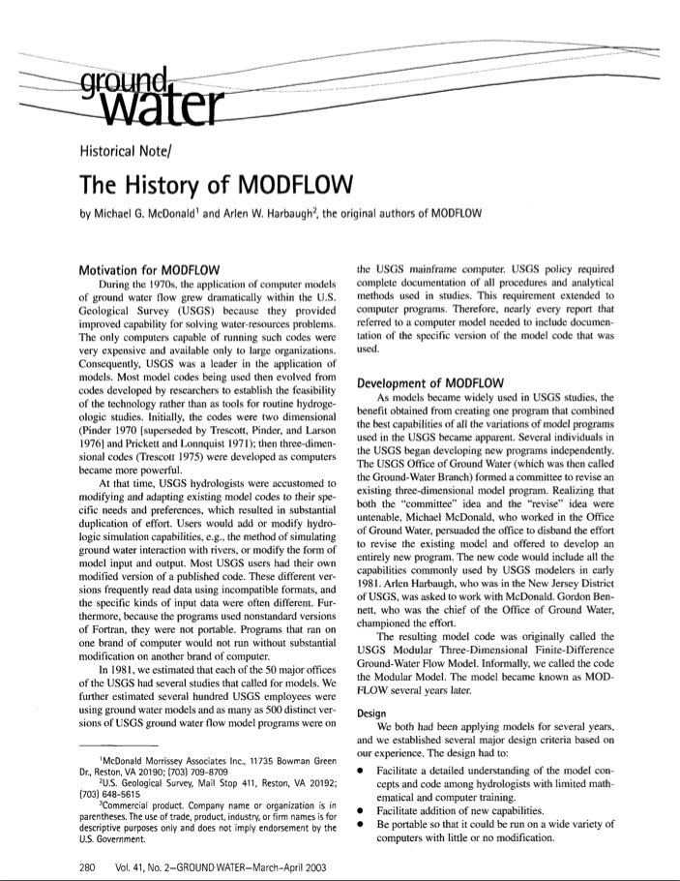
History
1970’s proliferation of groundwater models led to numerous diverging codes within the USGS
The best capabilities were combined to form MODFLOW

Slide 6
MODFLOW 6
MT3DMS
MT3D-USGS, USG
SEAWAT, SWI, GWT
GSFLOW-PRMS
SWB, HSPF, SWAT
OWHM
Solute and Heat
Transport
PHREEQC-PHT3D
PHWAT
RT3D
Landscape
Hydrology
Reactive
Transport
MODPATH
mod-PATH3DU
PATH3D
FlowSource
SAMG
PKS-MODFLOW
PKS-SEAWAT
MODFLOW 6
Parallel
Flow Path
Analysis
Groundwater Vistas GMS Visual MODFLOW PMWIN ModelMuse Groundwater Desktop Leapfrog Hydro FREEWAT iMOD ModelViewer FloPy Graphical Interfaces and Scripting
Core Principles
Teachable
Documented
Reliable
Robust
Efficient
Extensible
Portable
Subsidence
Karst and
Pipe Flow
SUB
CSUB
MODFLOW-USG
CFP, VKD
Unstructured
Grids
Management
PESTPP-OPT
MODSIM
GWM
MODFLOW-USG
MODFLOW 6
Parameter
Estimation
and Uncertainty
Unsaturated
Zone
Surface Water
Flow
PEST
PESTPP
UCODE
UZF
HYDRUS
VSF
SFR, SWR
HEC-RAS
BRANCH
MODFLOW
ECOSYSTEM OF CODES

Slide 7

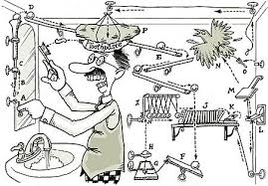
Philosophy of a “Production Code”
Easy to understand
Finite difference
Well documented
Extensible
Modular design
Portable
use standard Fortran
Efficient (memory and speed)
Judicious incorporation of new capabilities
Exclude functionality that can be done outside

Slide 8
MODFLOW “Core” Version
USGS maintains a “core” MODFLOW version
Most reliable and well tested
Starting point for new developments
Core versions
1984 – First release
1988 – Revised to FORTRAN 77
1996 – Minor update to improve ease of use
2000 – Parameter estimation
2005 – Revised memory structure
2017 – Object-oriented, unstructured, Newton-Raphson (MODFLOW 6)

Slide 9
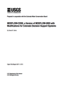
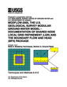
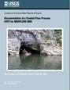

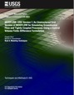


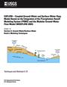
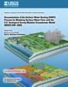
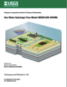
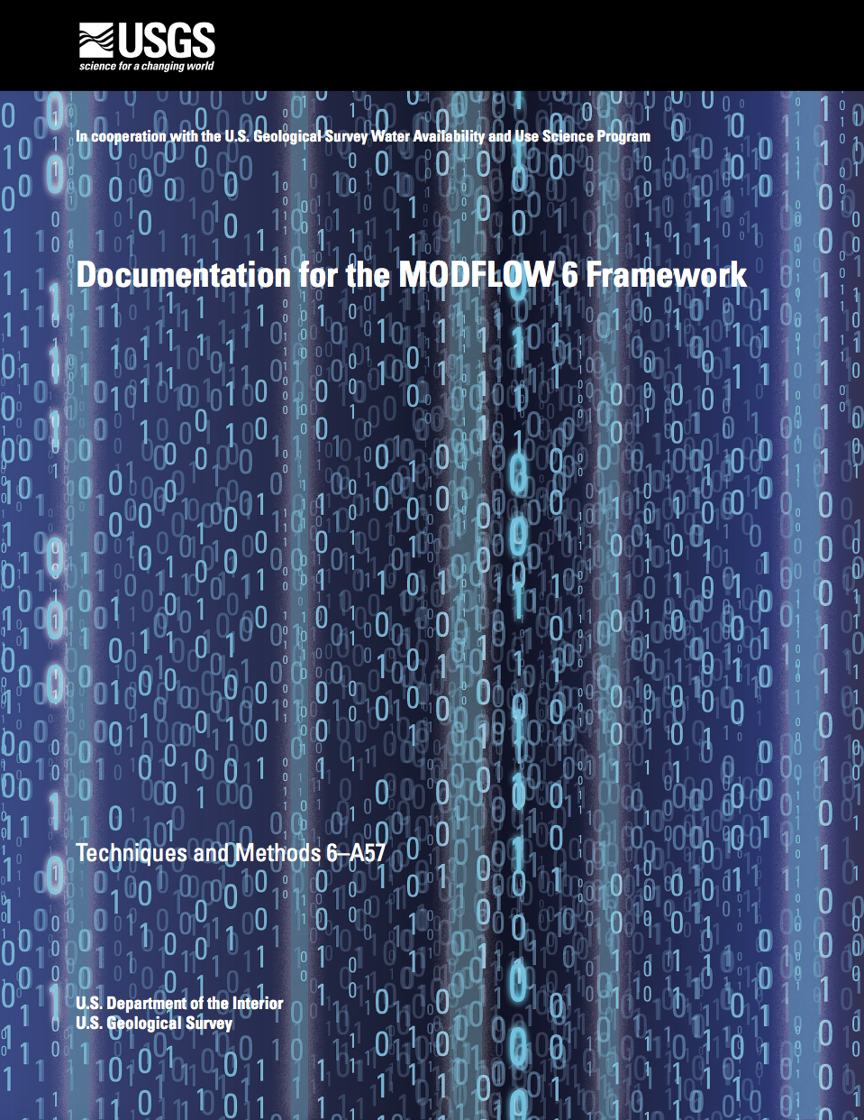


USGS MODFLOW Versions
2015
2005
2010

Slide 10
Quotes on MODFLOW Popularity
“A Geraghty and Miller survey of more than 5,000 groundwater modelers conducted in 1993 indicated MODFLOW was the most widely used groundwater model in the world. More than 23,000 copies of MODFLOW were downloaded from the main USGS web site from 1990 to 2000. Its popularity has continued, in part due to the modularity of the program and the resulting ability of USGS and others to add capabilities.”
Source: http://igwmc.mines.edu/software/igwmcsoft/MODFLOWreview.htm
“Part of MODFLOW’s popularity stems from its time-tested reputation in court proceedings, where it has withstood the scrutiny of many expert scientists.”
Source: Harter, T. and Morel-Seytoux, H. 2013. Peer Review of the IWFM, MODFLOW and HGS Model Codes: Potential for Water Management Applications in California’s Central Valley and Other Irrigated Groundwater Basins. Final Report.

Slide 11

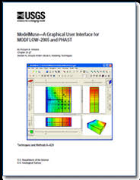
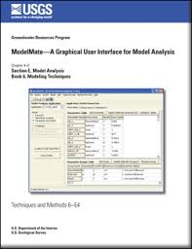
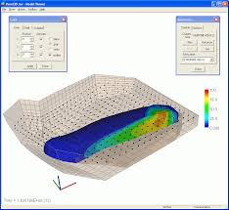
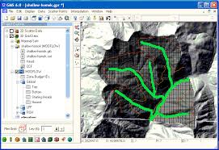
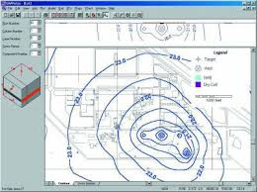
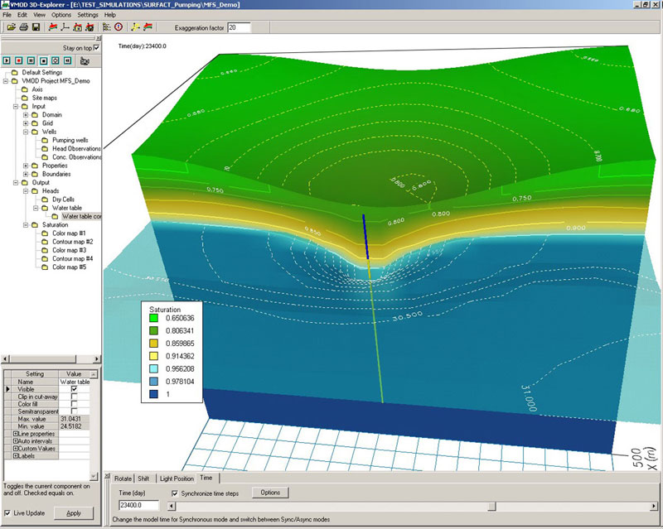
Graphical User Interfaces
USGS
ModelViewer
ModelMuse/ModelMate/GW_Chart
Commercial
Groundwater Vistas
GMS
Visual MODFLOW
PMWIN
Open Source
FloPy, mflab

Slide 12
PEST UCODE MT3D MT3D-USGS MODPATH GROUNDWATER VISTAS VISUAL MODFLOW GMS GROUNDWATER DESKTOP PMWIN ZONEBUDGET MODELMUSE GWCHART
MODFLOW-CFP GSFLOW SEAWAT MODFLOW-GWM MODFLOW-OWHM
MODFLOW-NWT MODFLOW-USG MODFLOW-LGR
MODFLOW
CORE
84, 88, 96, 2000, 2005, 6

Slide 13
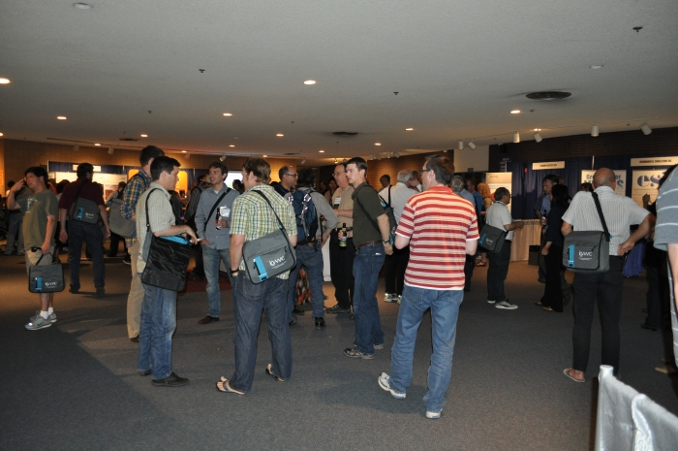
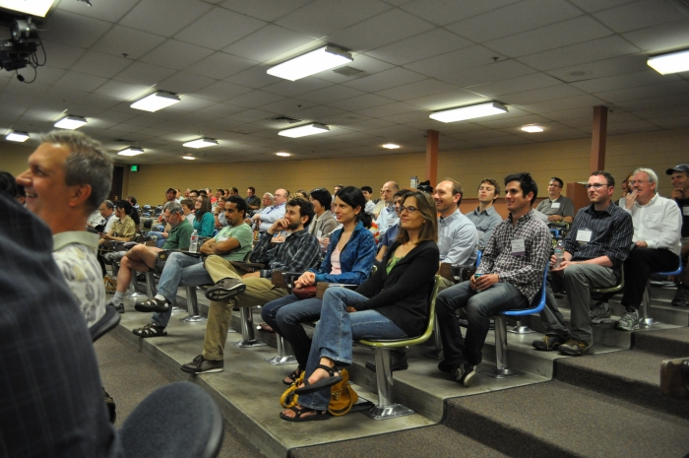
The MODFLOW and More Conference
Frequency:
Every 2-3 years at the Colorado School of Mines; now held at Princeton University
History
1998, 2001, 2003, 2006, 2008, 2011, 2013, 2015, 2017, 2019, 2022
Purpose
“bring together the users and developers of MODFLOW and related modeling programs to present the latest innovations in model applications, discuss the capabilities and limitations of MODFLOW, and explore the needs and directions for future developments.”

Slide 14
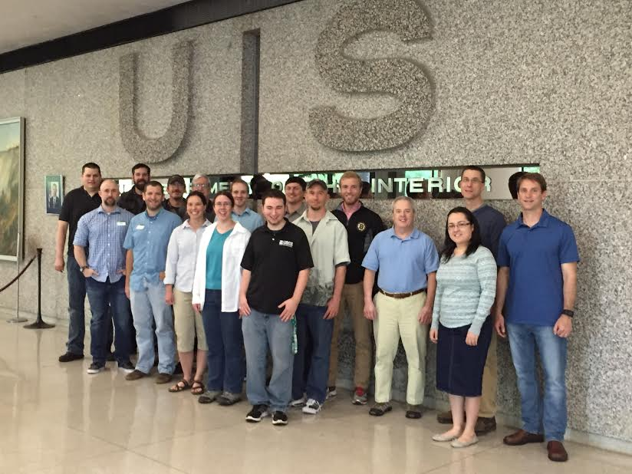
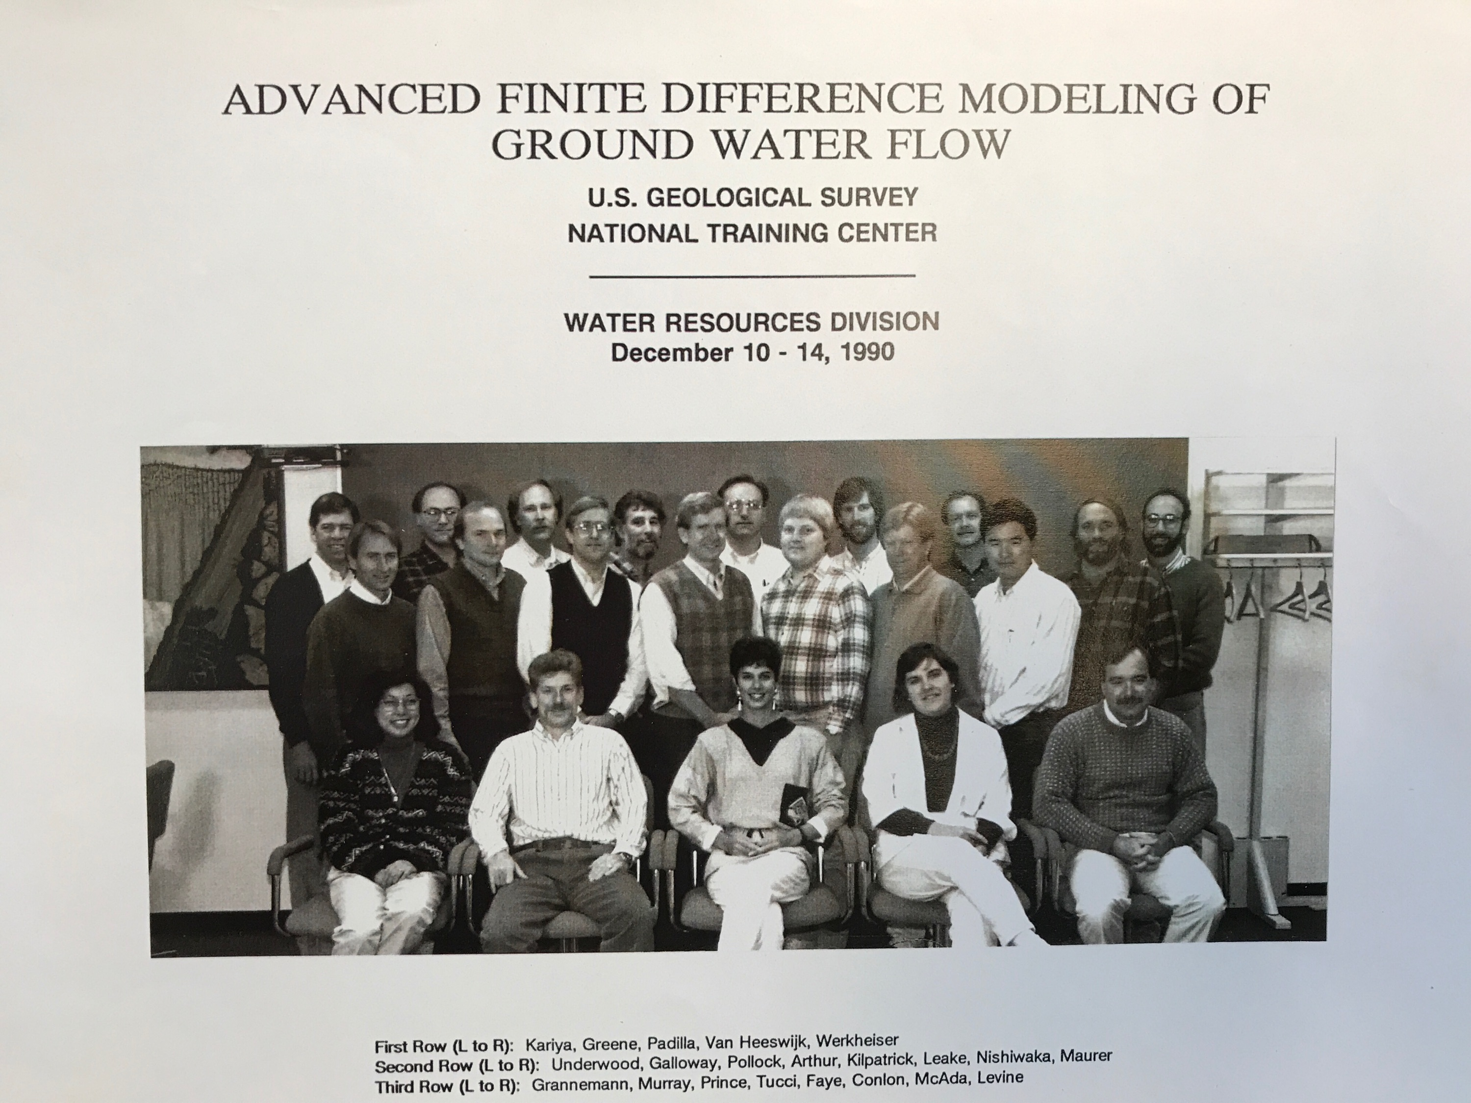
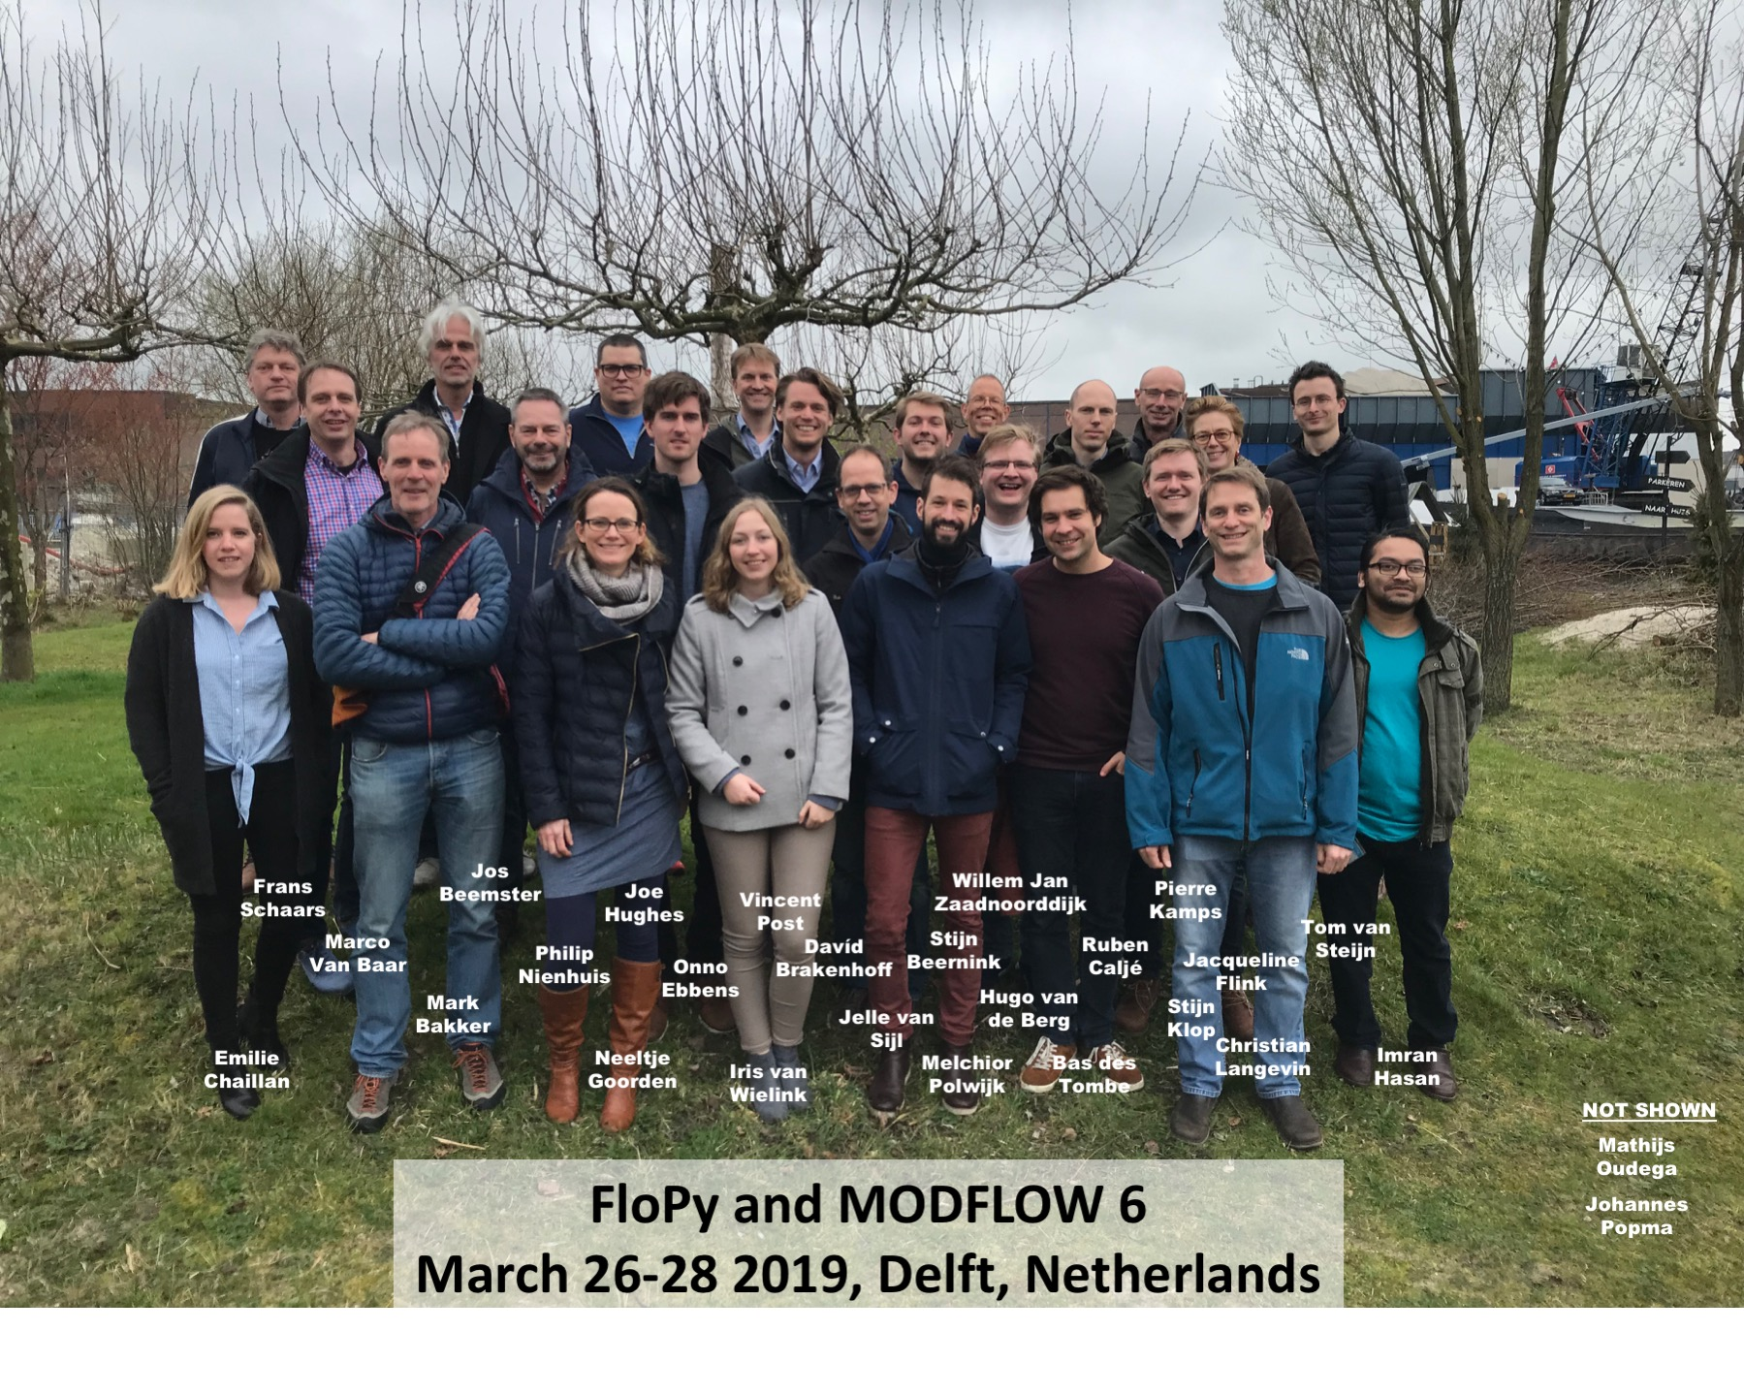
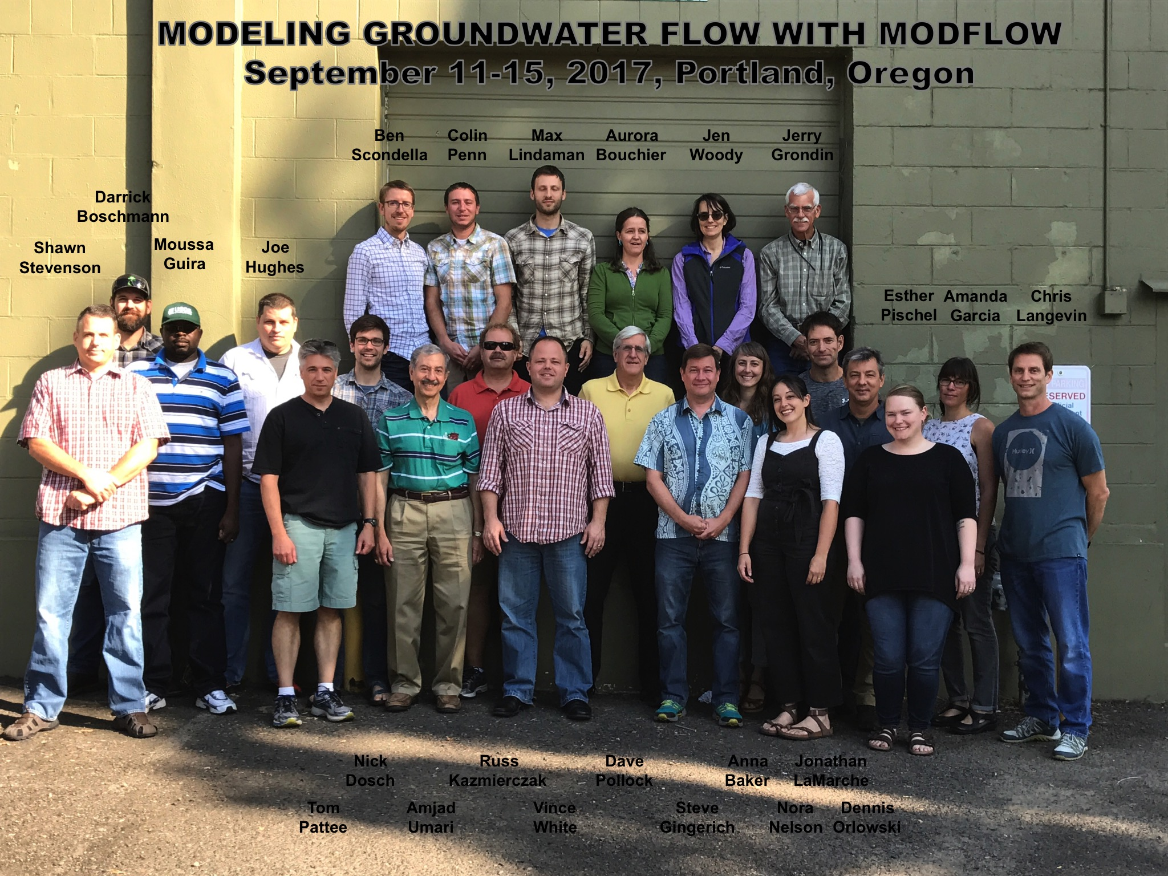
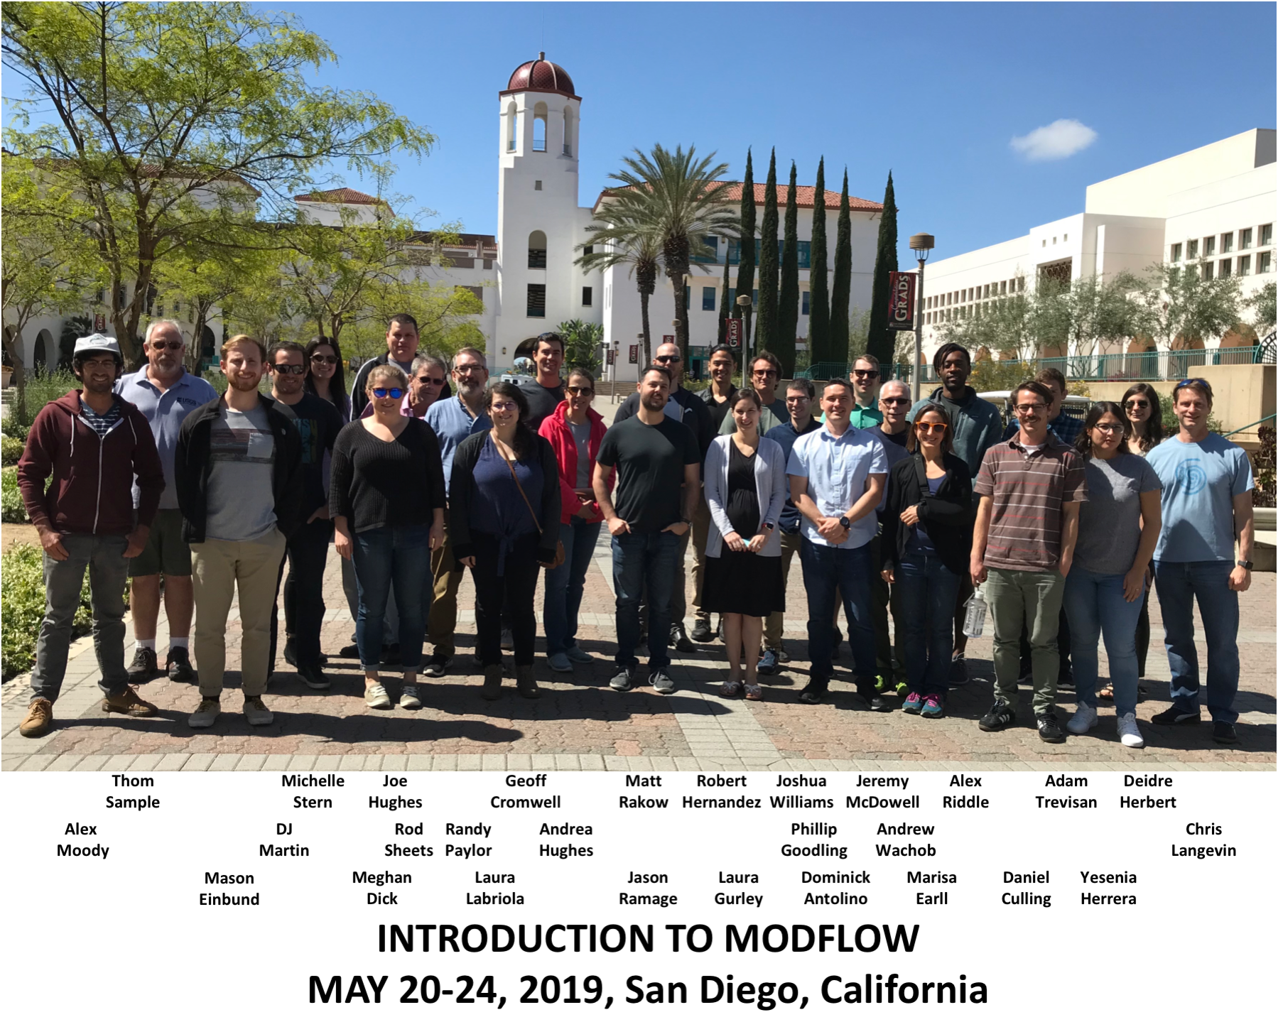
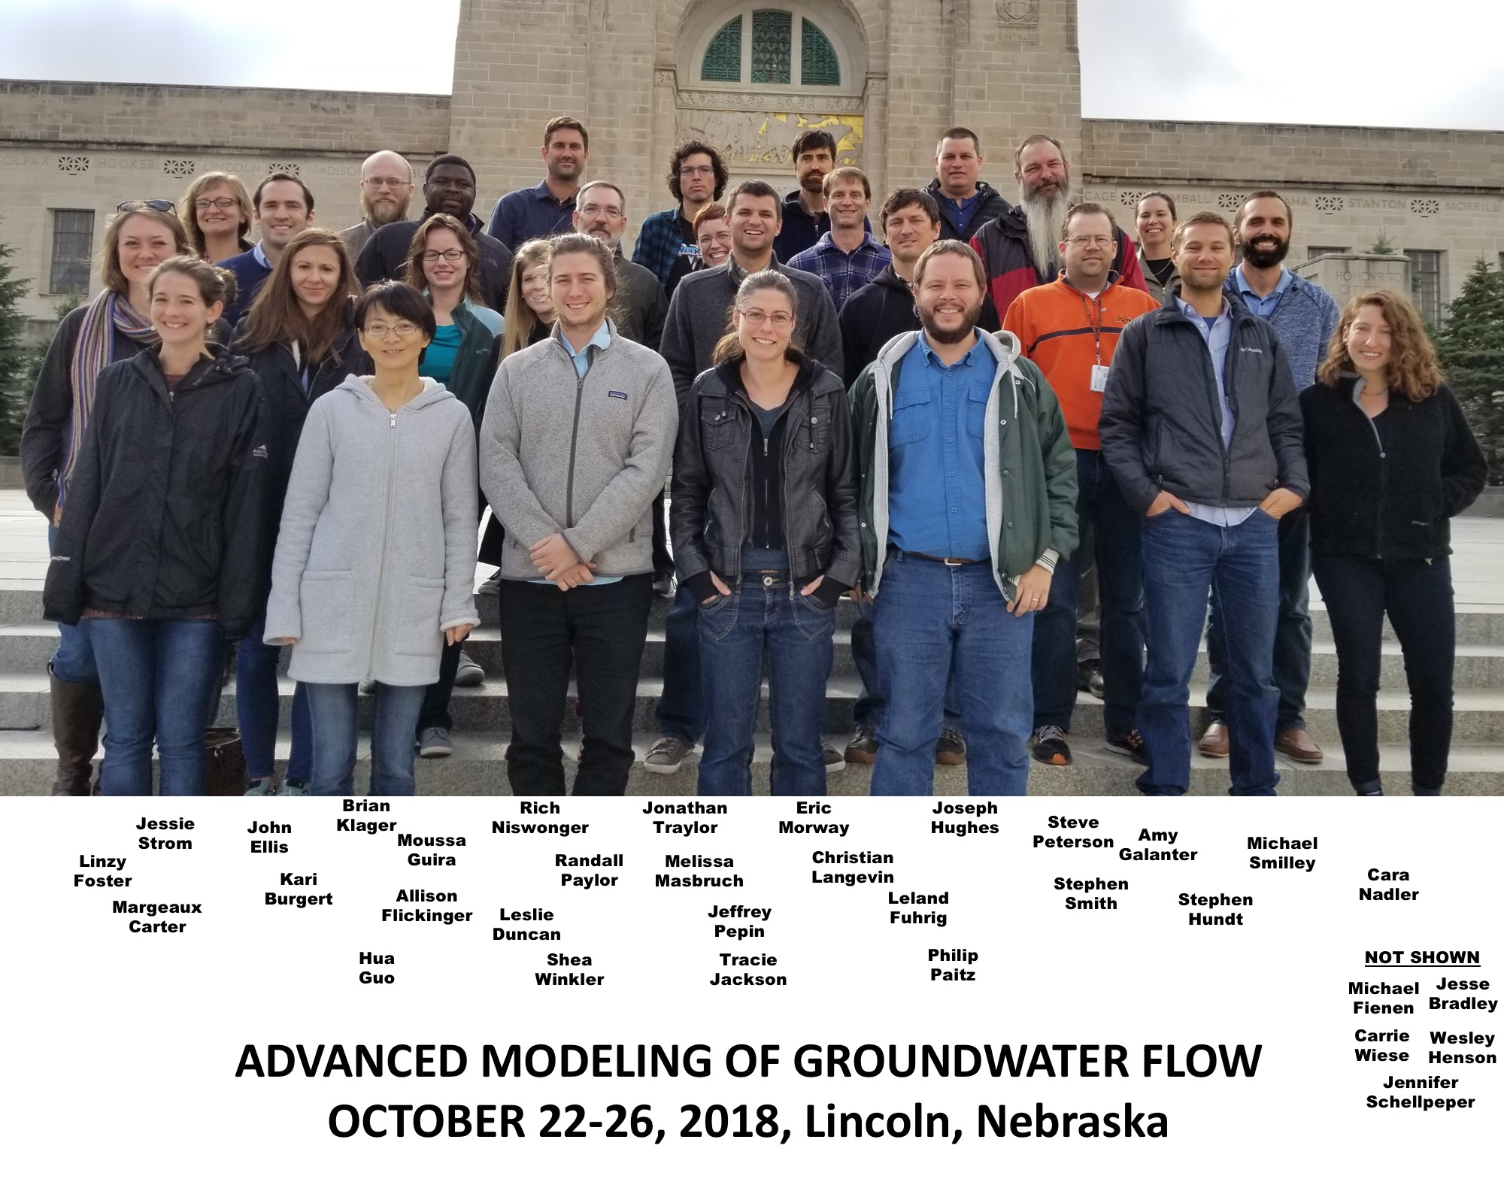
Training

Slide 15
MODFLOW 6

Slide 16
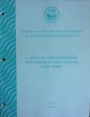
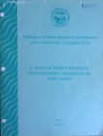
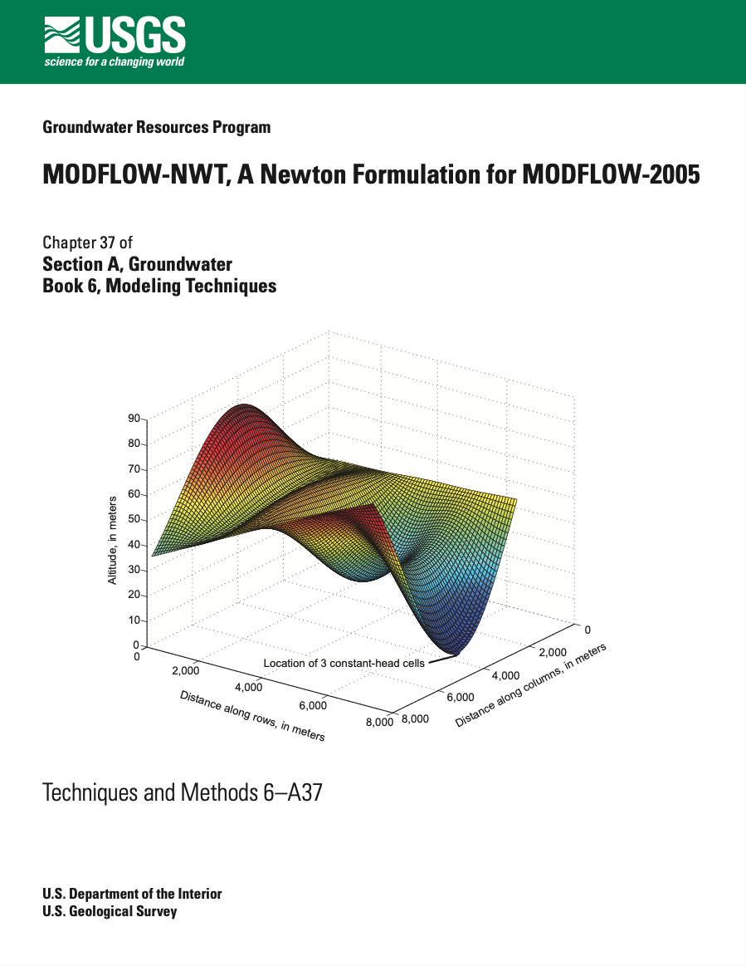
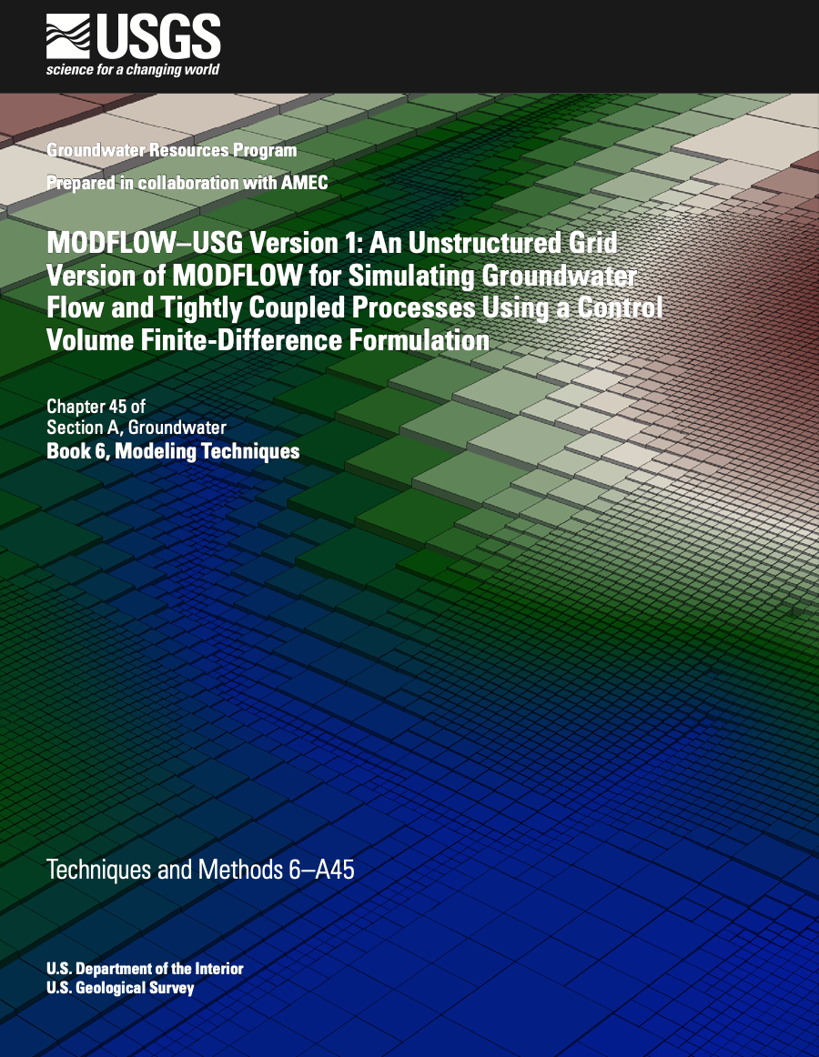
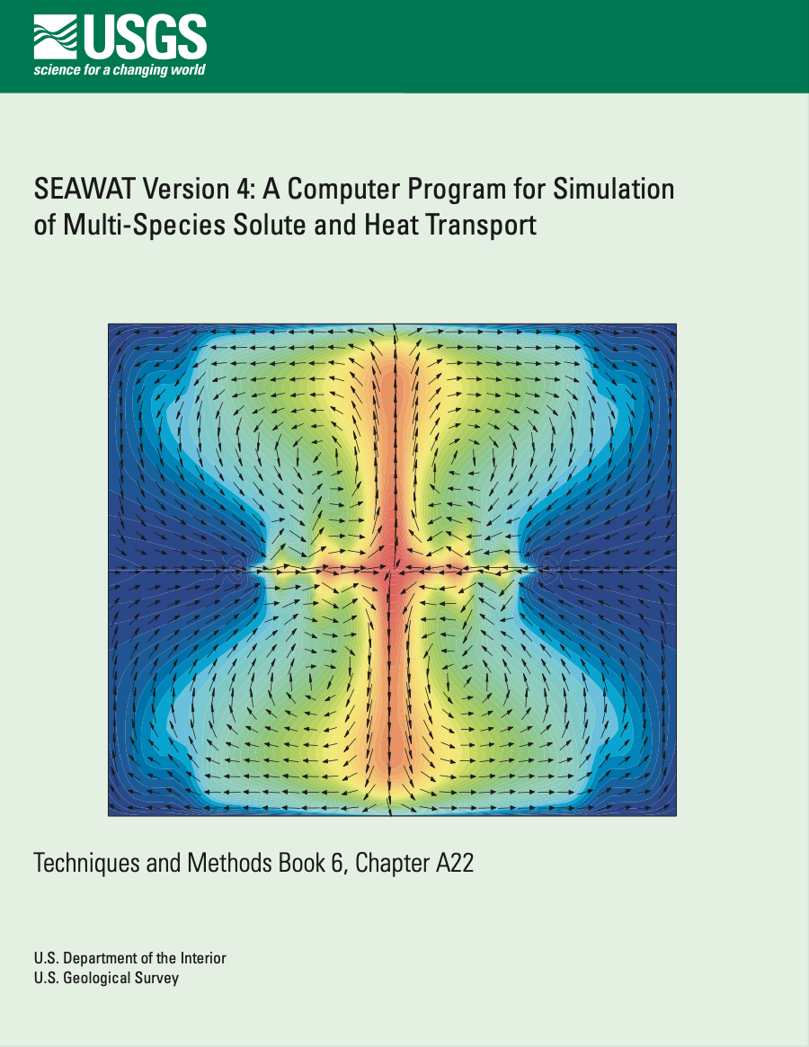
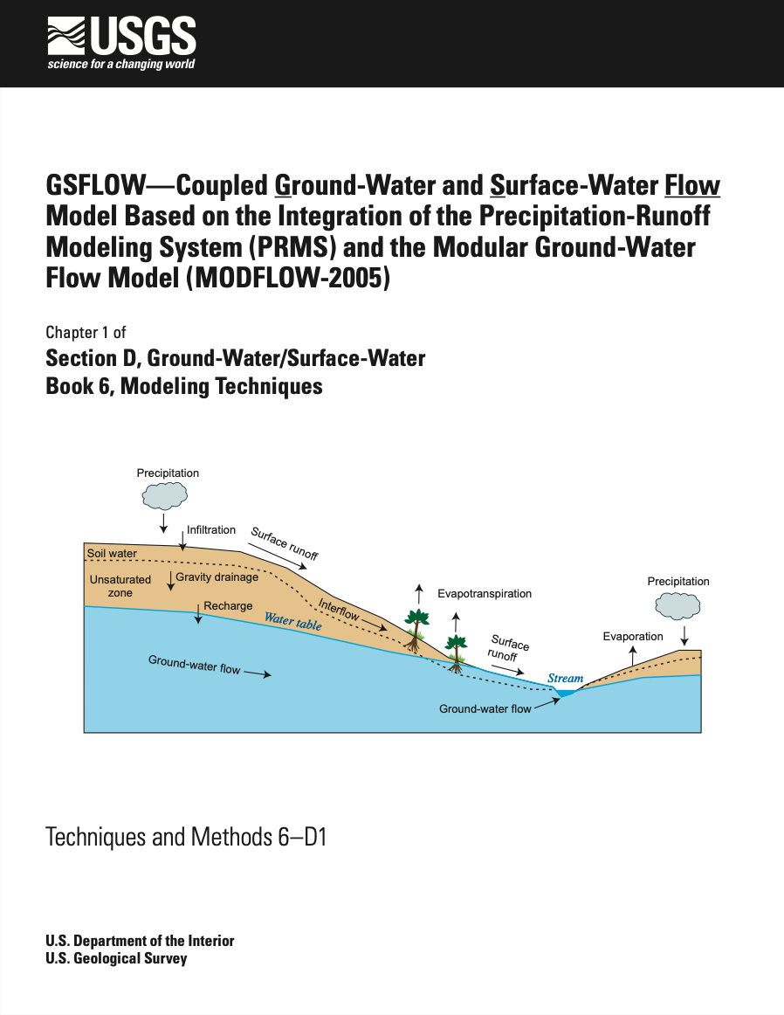
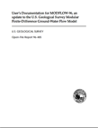
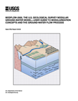
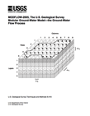
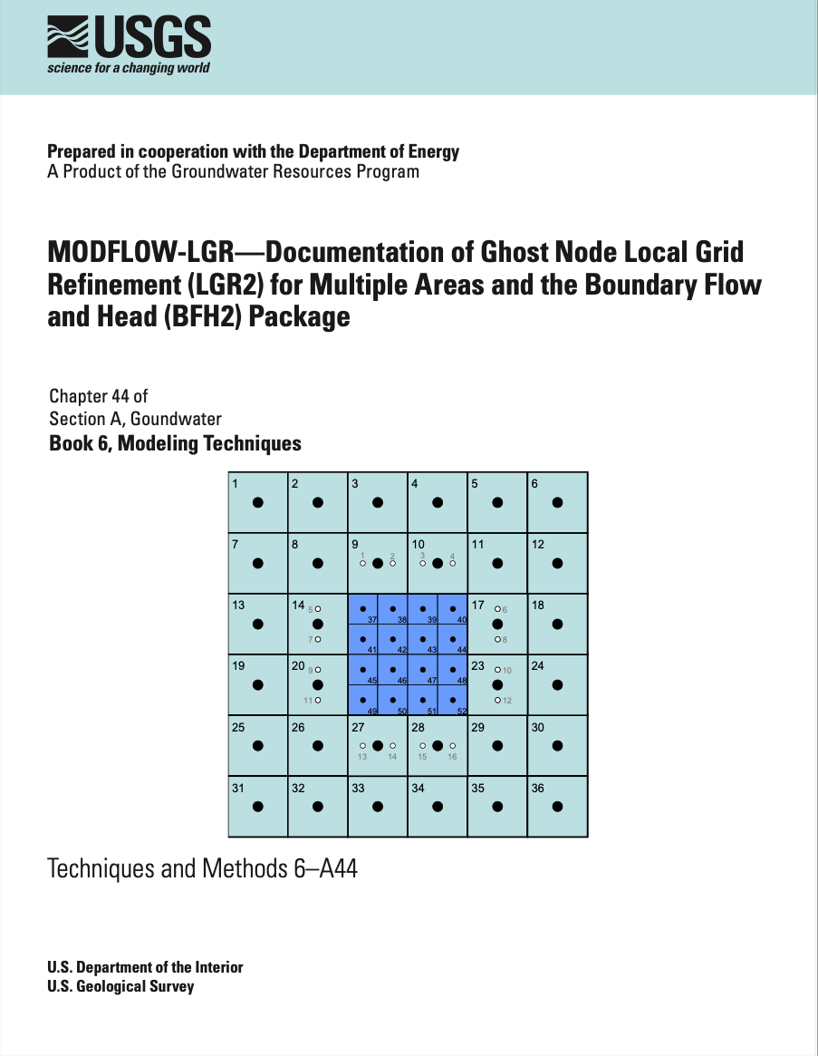
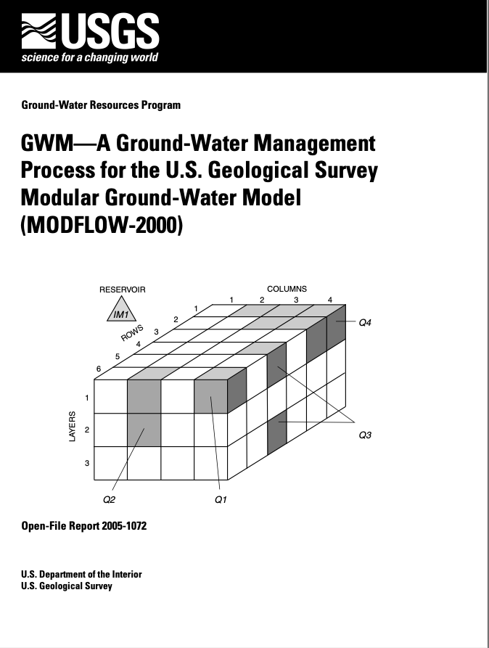
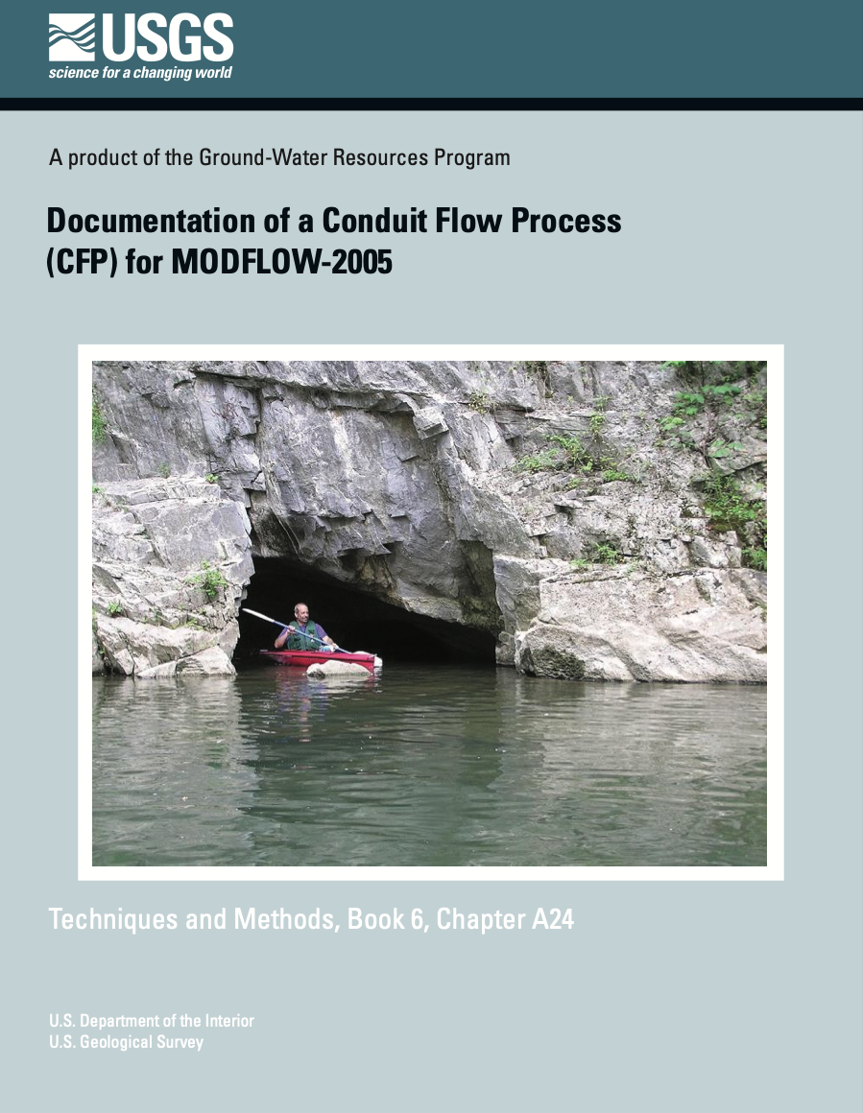
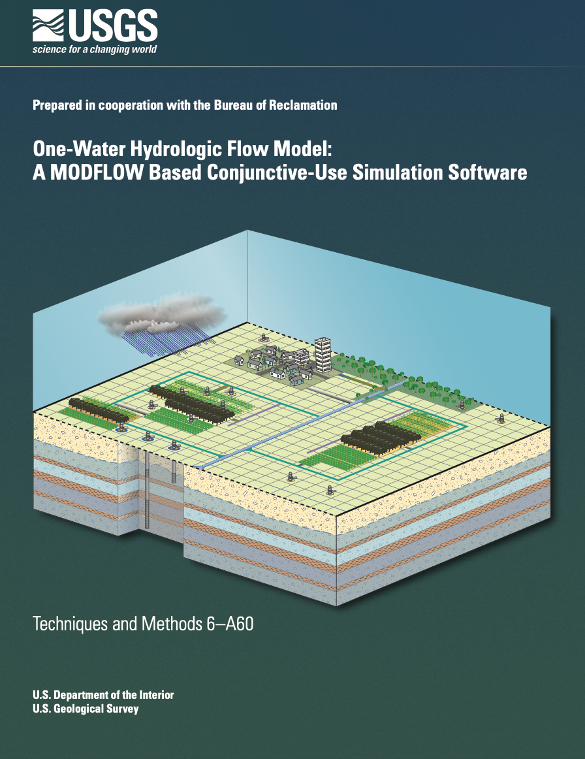
MODFLOW Versions
Core
Development Paths
Advanced
NWT
USG
SEAWAT
GSFLOW
1984
1988
1996
2000
LGR
GWM
CFP
OWHM
2005
Notes:
From the USGS perspective, we have tried to maintain a “core” version of MODFLOW that could be relied upon for production. From this core version, we supported MODFLOW offshoots to implement and extend MODFLOW for new purposes. Once vetted and shown to be generally useful, these capabilities were brought into the core version, often time requiring redesign of the core version.

Slide 17
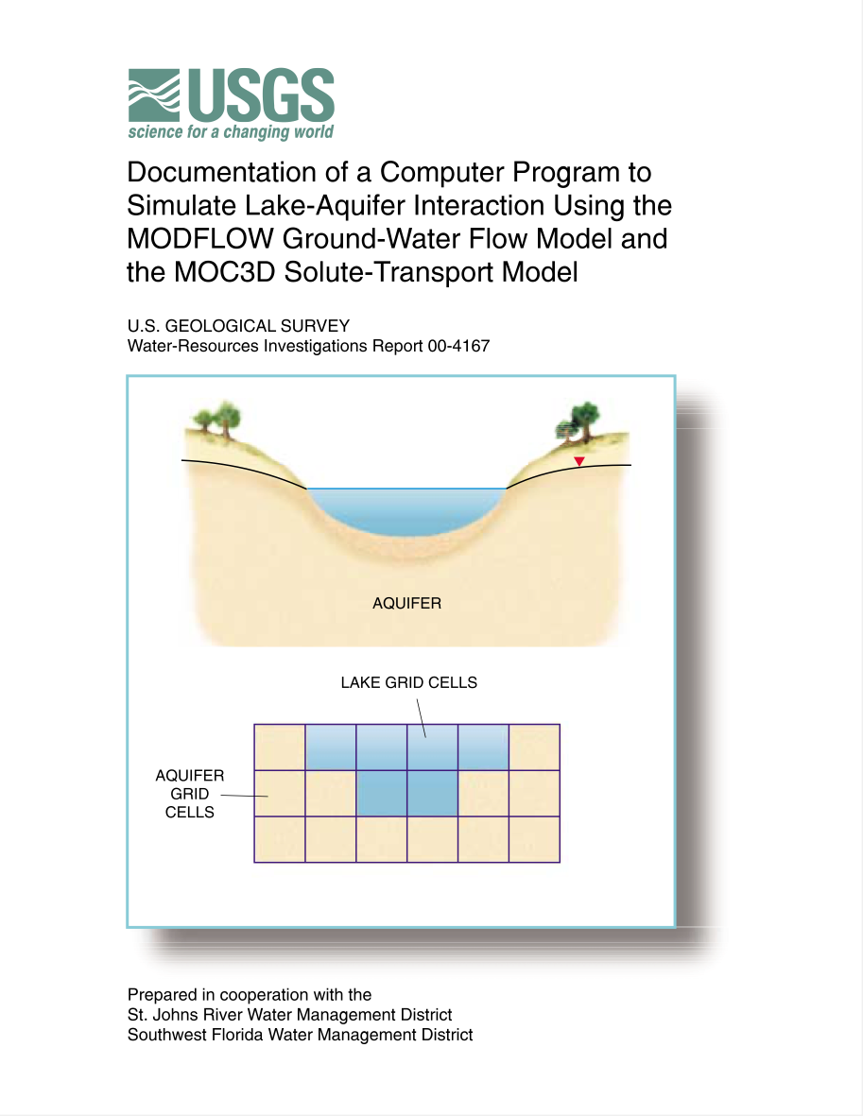
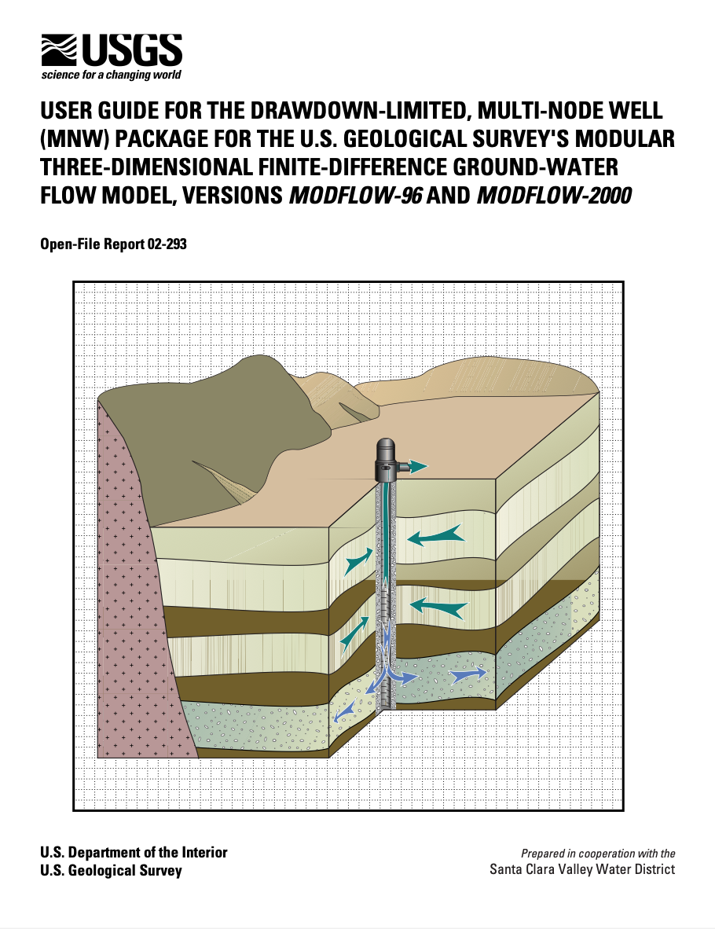
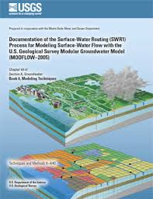
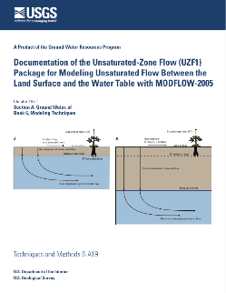
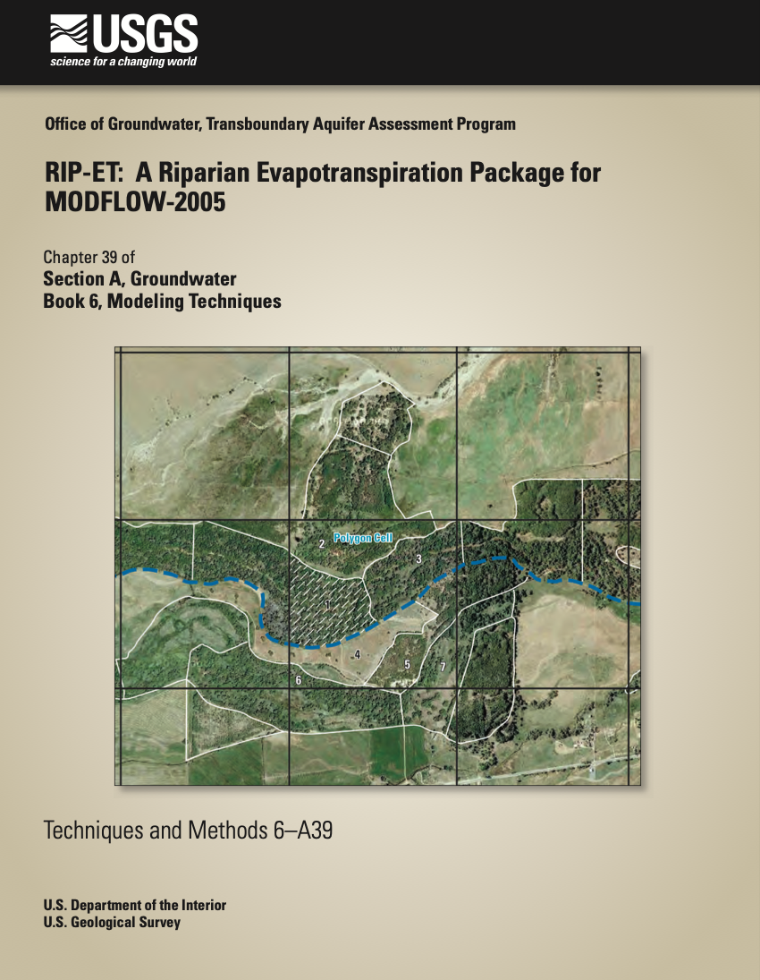
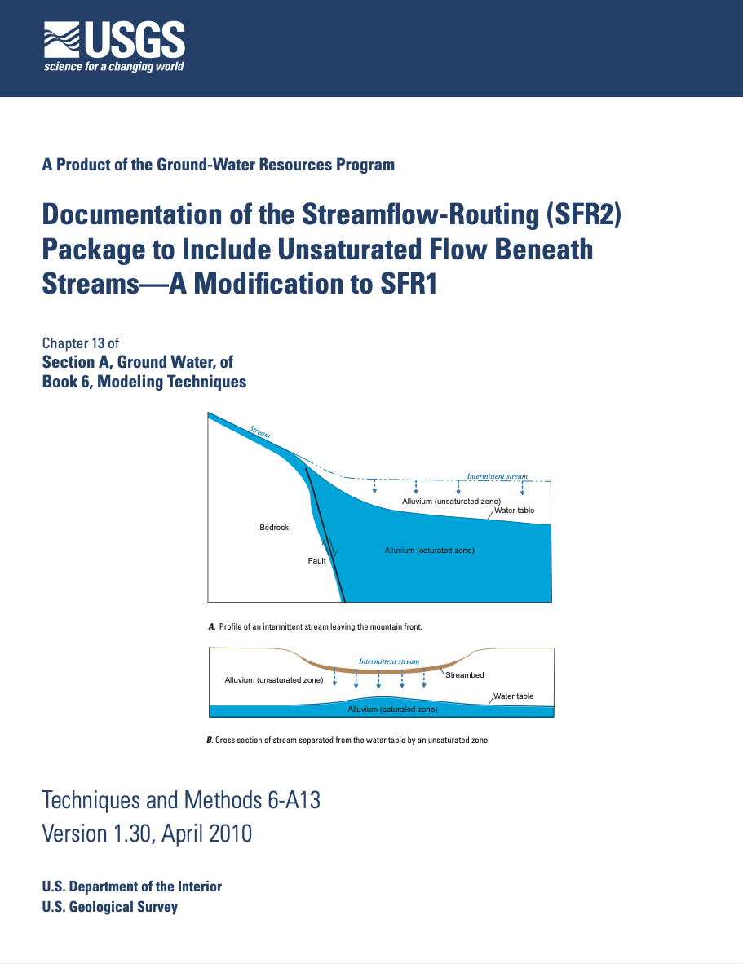
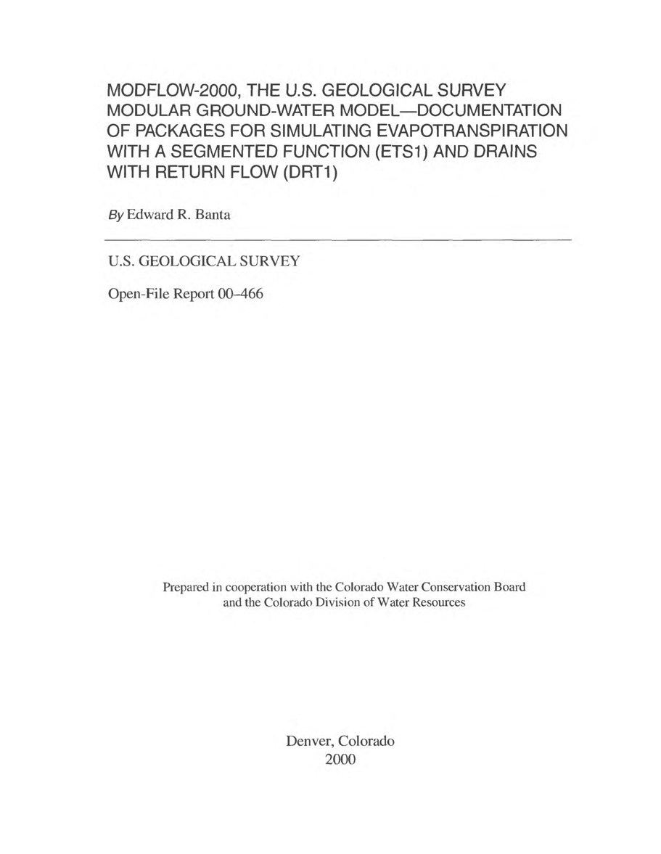
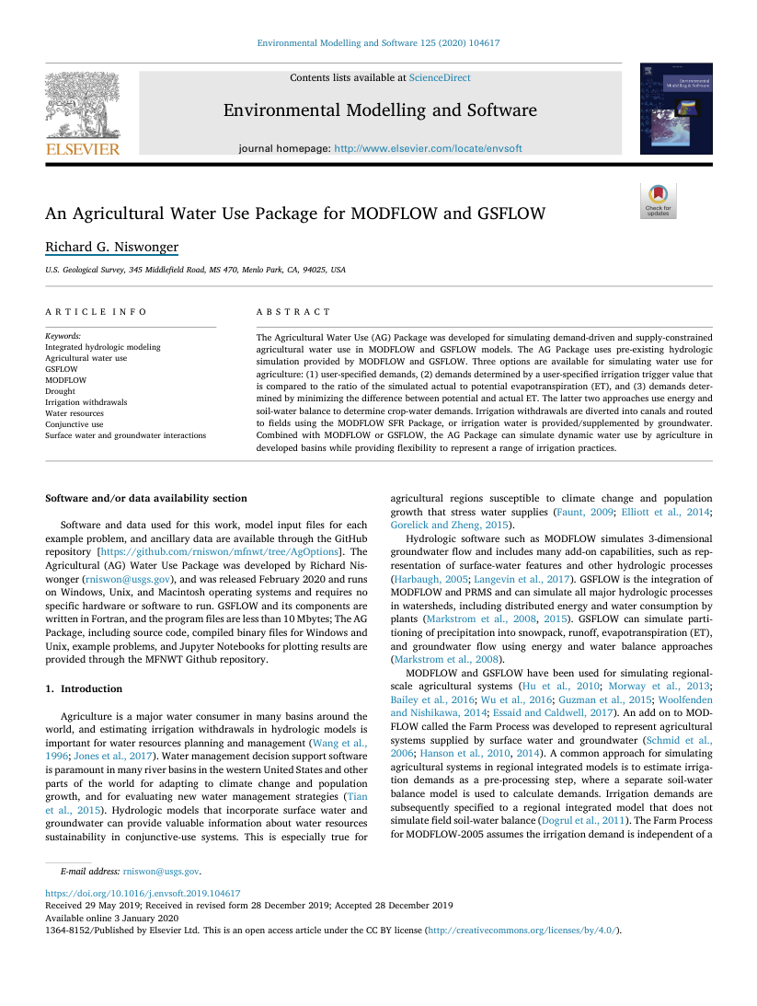
MODFLOW Packages
Packages have become more complex over time, and in many cases, they model a physical process
Notes:
The package concept in MODFLOW has been a nice way to compartmentalize the effect of boundary condition or stress on an aquifer. Packages were designed to be independent and act solely as a stress on an aquifer. Over time, packages became much more complex, often times representing a full hydrologic process, such as stream flow. Furthermore, it became necessary for packages to communicate with other packages, requiring new wiring that was never part of the original MODFLOW structure.

Slide 18
MODFLOW 6 Development
Initiated by the USGS in 2013 to extend MODFLOW from a groundwater simulator into a hydrologic simulator
Initial goal to support capabilities from
MODFLOW-2005
MODFLOW-NWT
MODFLOW-LGR
MODFLOW-USG
MOC3D / MODFLOW-GWT
SEAWAT
Advanced packages
Released in 2017
Notes:
In 2013, the USGS Office of Groundwater initiated a complete MODFLOW overhaul to extend MODFLOW from a groundwater simulator into a hydrologic simulator. The idea was to design a framework that could build upon the best features of many of the existing MODFLOW versions and related programs. Much of this redesign focused on the capability to tightly solve multiple models, packages, and their connections within a single matrix solution. Object-oriented concepts were used to encapsulate different MODFLOW components so that any number of them could be created by the user for a simulation.

Slide 19
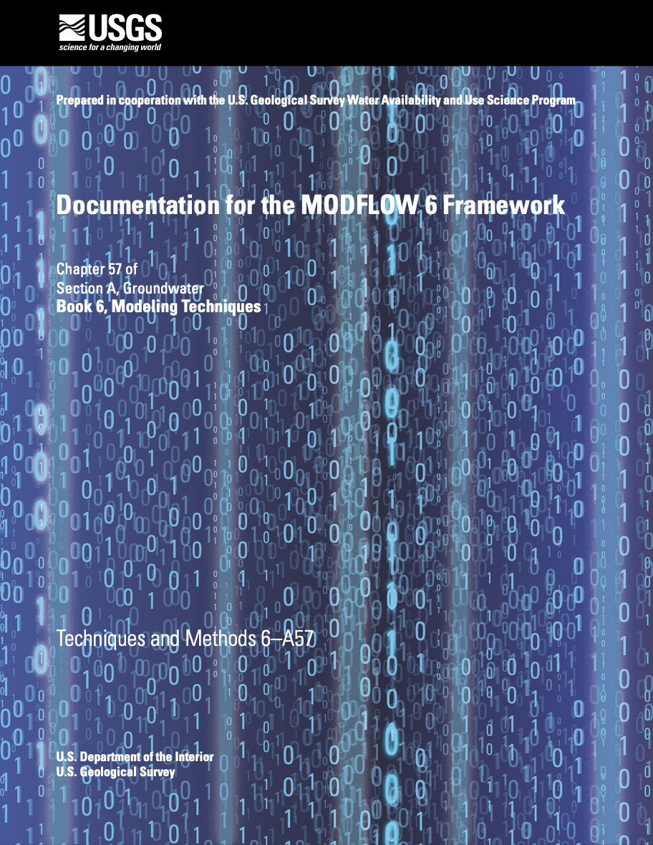







MODFLOW 6 Documentation
Framework
Groundwater Flow
XT3D
Variable Density Flow
Water Mover
Groundwater Transport
Subsidence
Application Programming Interface (API)
Notes:
We have spent a large amount of time documenting MODFLOW 6 to ensure that the underlying concepts, equations, and technical details are available to users. In addition to the unpublished documents that we distribute with MODFLOW 6, we have 8 published reports and papers.

Slide 20




Guiding Principles
PRODUCTION CODE
Documented
Teachable
Extensible
Reliable
Portable
MODERN
Continuous integration
Automated testing
Object oriented
Version control
Open source
MULTI-MODEL
FRAMEWORK
Groundwater
Surface water
Flow / transport
Structured / unstructured
FLEXIBLE
COUPLING
Matrix-level tight coupling
Asymmetric matrix equations
Unstructured matrix equations
Embedded or API model coupling

Slide 21
Options for Adding New Capabilities
Option 1 – Embed new capability
Option 2 – Link to external capability using API
Advantages
MODFLOW look and feel
Leverage our existing automated procedures for documentation and testing
Easy to compile and distribute
Disadvantages
Requires writing new code in Fortran that follows our conventions
Advantages
Mechanism for coupling with established models
External models can be tightly coupled with MODFLOW
Can use other programming languages, such as Python
Disadvantages
May require some reworking of existing model to support the Basic Model Interface
May be challenging for users to learn and work with different software packages
Notes:
MODFLOW has always been a community model, and people have been free to add new capabilities. There is a huge ecosystem of MODFLOW variants, custom packages, and support programs. MODFLOW 6 has two different ways that someone can add a new capability. With option 1, which is consistent with how it’s been done in the past, anyone can add a new package, model, or function by adding new Fortran code and compiling the program into an executable. TVK and TVS is an example of this, which was complete by Damian Merrick.

Slide 22

MODFLOW 6.4.1

